Slide 1
Organization Name
Workplace Charging Challenge
Presenter
Ambassador Organization
Date
Title
E-mail
Notes:
[Introduce yourself, your organization and other representatives from your organization.]
We know that in this competitive marketplace, your company cares about recruiting and retaining top talent, increasing brand visibility, and ultimately improving your bottom line.
As part of the Workplace Charging Challenge, we care about the national, economic and environmental security of our nation and one thing that threatens that is our high consumption of oil. About 8 million barrels of oil are imported daily. That means nearly 1 billion dollars goes overseas every single day. About 3 out of every 4 of those barrels of oil are used in the transportation sector. So, to really address this issue, we must focus on reducing petroleum used for transportation. (1)
One way of doing this is by replacing petroleum with a domestic fuel source such as electricity.
For consumers to make the move to an electric fuel source though, the country must build its charging station infrastructure. Having charging stations at the workplace is one key area for installing charging stations.
Today we’re going to discuss how our interests intersect with your interests as a U.S. employer, and how we can engage in a mutually beneficial relationship.
[Insert information about specific Ambassador organization]
(1) US Census Bureau, Foreign Trade Division, 2013. “US Imports of Crude Oil.” http://www.census.gov/foreign-trade/statistics/historical/petr.pdf
Photo: "To support its corporate car share program and encourage its employees to buy their own PEVs, Google offers free workplace charging at its Mountain View headquarters and several other company locations in the United States." (Photo courtesy Google)
[For Ambassadors’ reference]
Google has 25,000 employees and 300 charging stations across the country. The company’s goal is to provide charging at 5% of its parking spaces.

Slide 2
Goal: Affordable & Convenient Plug-In Electric Vehicles (PEVs)
Notes:
The national EV Everywhere Grand Challenge aims to make American-made PEVs that are as affordable and convenient as today’s gasoline-powered vehicles by 2022 (1).
Efforts in support of EV Everywhere consist of:
A technology push of research and development to reduce the cost of PEVs
Charging infrastructure development to enable the convenience of fueling PEVs
PEV education to help consumer acceptance of PEVs and create a market pull
While there are needs in all three of these focus areas, today we’re talking about the opportunity to build our community’s PEV charging infrastructure through the Workplace Charging Challenge.
(1) US DOE, 2013. “EV Everywhere Grand Challenge Blueprint.” http://www1.eere.energy.gov/vehiclesandfuels/electric_vehicles/pdfs/eveverywhere_blueprint.pdf

Slide 3
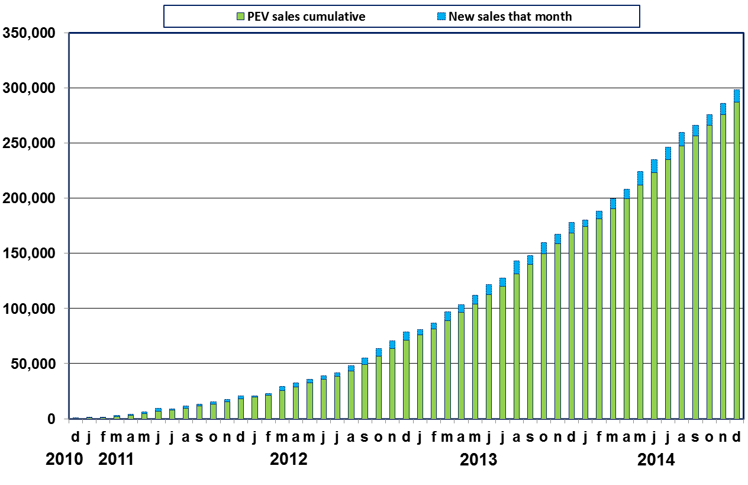
U.S. PEV Sales Rising
Source: Argonne National Laboratory for US Department of Energy, revised Dec 2014
Notes:
Workplace Charging Challenge efforts to promote PEVs align with a rapidly growing PEV market
Plug-in electric vehicles are here today- and they can help increase energy security by reducing our dependence on oil, improving fuel economy, lowering fuel costs, reducing maintenance costs, and reducing emissions. With these benefits, we’re seeing consumer excitement, and interest in PEVs is growing.
Through January 2015, more than 286,000 PEVs have been sold since their first introduction four years ago. In 2014 alone, more than 118,000 PEVs were sold in the United States, a more than 20 percent increase over 2013.
Chart data source: Argonne National Laboratory for U.S. Department of Energy, September 2013, “Light Duty Electric Drive Vehicles Monthly Sales Updates.” http://www.transportation.anl.gov/technology_analysis/edrive_vehicle_monthly_sales.html

Slide 4





Continued PEV Market Growth
New PEVs Available for Consumer Purchase
2009
2010
2011 2012
2013
2014-2015
80%
Percent of PEV owners who plan to buy another PEV in the future
…even more models to choose from!
Notes:
Automakers are showing that their PEVs are on par with gasoline-powered vehicles on the market. As PEVs become increasingly attractive to consumers, we may see PEV sales take an increasing share of the automotive market.
PEVs are winning awards based on their superior vehicle performance, safety and sustainability.
PEVs have topped the Consumer Reports owner satisfaction survey for the last three years: The Chevrolet Volt in 2011 and 2012, and the Tesla Model S in 2013 and 2014, with a score of 98 out of 100 total points.
Plug-in vehicles received numerous accolades in 2014 including World Green Car of the Year and World Design Car of the Year and 2013 accolades of Car of the Year by both Motor Trend and Automobile Magazine.
Automakers are responding to consumer interest with more vehicle options [CLICK ANIMATION 1]. You can see that in the earlier years of modern consumer PEV models, there were only a few different models available. However, in 2014 and 2015, auto manufacturers have already or plan to introduce at least 15 new models of PEVs. The number of models of vehicle models available is on the rise.
And once consumers buy their PEV, they’re having very positive experiences [CLICK ANIMATION 2]. A survey by JD Power and Associates showed that over 80% of PEV owners intend to purchase another PEV of the same brand in the future (1).
JD Power and Associates, November 2012. “2012 Electric Vehicle Ownership Experience Study” http://autos.jdpower.com/content/press-release/X0Iqfsz/2012-electric-vehicle-ownership-experience-study.htm

Slide 5
Workplace = Prime Charging Opportunity
Leisure Destination
Shopping Centers
Travel Stops
Workplace
Day in the life of an average car
6.5-8+ hours
47 min- 2 hours
28-48 min
15-53 min
Notes:
Employers are positioned to build non-residential charging where it is needed most.
Second only to the home, the workplace is where PEV drivers and their vehicles spend most of their time. PEV drivers park their cars at the workplace for 6.5 to 8 or more hours a day, meaning that workplace charging demonstrates the largest infrastructure gap (1). However, it is also provides the greatest opportunity for PEV charging.
Additionally, it is estimated that approximately 50 million PEV drivers will require workplace or public charging to make their daily commute (2). Many of these individuals are those who live in multi-unit or urban dwellings where they lack access to home charging.
You, a U.S. employer, have the opportunity to help fill the workplace gap in America’s charging infrastructure and provide greater transportation options for your employees.
Chen, Khan and Kockelman, 2013. “The Electric Vehicle Charging Station Location Problem: A Parking-based Assignment Method for Seattle.” Proceedings of the 92nd Annual Meeting of the Transportation Research Board. AND National Research Council of the National Academies, 2013. “Overcoming Barriers to Electric-Vehicle Deployment: Interim Report” http://www.nap.edu/catalog.php?record_id=18320
U.S. Energy Information Administration, 2009, “Residential Energy Consumption Survey.” http://www.eia.gov/consumption/residential/data/2009/index.cfm?view=characteristics

Slide 6
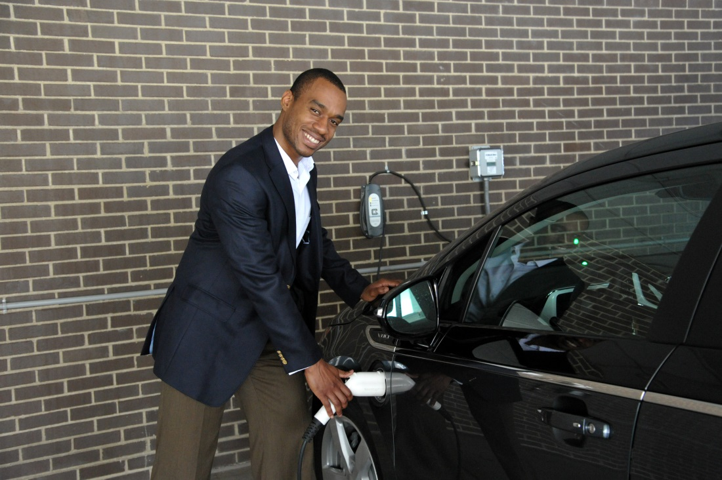

Workplace Charging is Valuable to Employees
Peer Effect
Current PEV Drivers
Increased range confidence
Increased electric vehicle miles traveled
Potential PEV Drivers
Increased PEV awareness and education
Notes:
Workplace Charging is valuable to current and potential PEV-driving employees
Not only does workplace charging address a great need for many PEV drivers, it also alleviates a significant concern for current potential PEV drivers. Workplace charging availability will help current PEV drivers by
doubling the distance an electric vehicle can drive each day, which allows for more driving spontaneity, and
adding electric vehicle miles traveled
For your other employees who are potential PEV drivers, offering workplace charging increases PEV awareness and education. As people see their coworkers plugging in, they’ll begin to realize that PEVs are practical for their daily lives.
Most importantly, workplaces serve as a second showroom, and workplace charging facilitates the peer effect. Just like colleagues like to talk about sports, movies, or travel, they will love to talk about their new car and the new charging stations in the parking lot.
Photo 1: "In 2013, the New York Power Authority (NYPA) installed three employee charging stations at its White Plains, New York, facility, as part of its workplace charging pilot program." (Photo courtesy NY Power Authority); Photo 2: iStockphoto
[For Ambassadors’ reference]
New York Power Authority has 1,623 employees and three charging stations strictly for employee use at the main office in White Plains, NY.

Slide 7
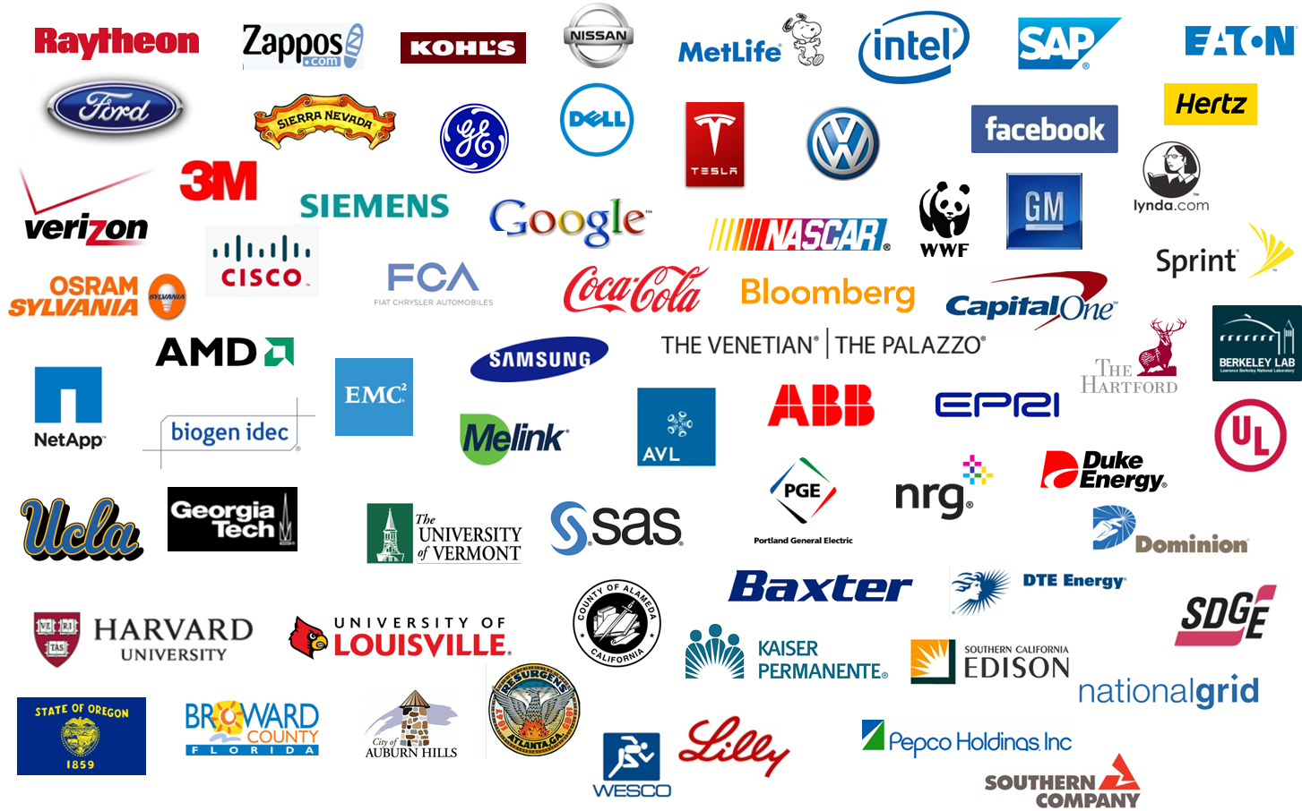
Snapshot of the 175 Partners
Your Logo Here!
Notes:
Leading U.S. employers have recognized the benefits of workplace charging and have taken the Workplace Charging Challenge Pledge.
The Workplace Charging Challenge was launched by the U.S. Department of Energy in 2013 to grow the nation’s non-residential PEV charging infrastructure and increase consumer awareness of PEV technology by supporting employers in their efforts to establish workplace charging programs.
The Challenge aims to achieve a tenfold increase in the number of U.S. employers offering workplace charging by 2018.
[CLICK ANIMATION 1] Like other employers that have already taken on the Challenge, your organization will find that it can reap the benefits of workplace charging.

Slide 8
Leading Employers Join Workplace Charging Challenge
200 Market Associates
3M
ABB
Advanced Micro Devices
Advocate Health Care
AeroVironment, Inc.
Appalachian State University
Arkansas Power Electronics
Atlanta Regional Commission
Austin Energy
Avista Utilities
AVL
Baxter Healthcare Corporation
BECO South
Bentley Systems
Biogen Idec
Bloomberg LP
BMW North America
BookFactory
Capital One
CFV Solar Test Laboratory
ChargePoint
Cisco
City of Atlanta
City of Auburn Hills
City of Beaverton
City of Hillsboro
City of Palm Springs
City of Sacramento
Classique Floors
Clipper Creek
College of Lake County
ComEd
Concurrent Design
Conrad N Hilton Foundation
Consumers Energy (ConEd)
Continental Electrical Construction Company
County of Alameda
County of Broward, FL
Dell
DIRECTV
Dominion Resources
DTE Energy
Duke Energy
Duro-Last
Eaton
El Camino Real Charter High School
Electric Applications Inc
Electric Power Research Institute
Eli Lilly
EMC Corporation
EMD Serono
Envision Solar
EV Connect
EV Grid
Evolution Marketing
Facebook
FCA US
FEV
Ford
Fraunhofer Center for Sustainable Energy
Systems
Freedom Solar
Freudenberg-NOK
Fuji Electric Corp. of America
General Electric
General Motors
Georgia Institute of Technology
Google
Great River Energy
Green Cab VT
Green Mountain Power
Green Wheels
Greenlots
Hannah Solar
Harris Civil Engineers
Harvard University
Heartland Community College
Hertz
Hollywood Woodwork
IBEW #48
IDEXX Laboratories, Inc.
Intel
JEA
JLA Public Involvement
Kaiser Permanente
Kankakee Community College
Kansas City Power and Light Co
Kaskaskia College
KEMET
Kia Motors America
Kohl's
Lane Regional Air Protection Agency
Lawrence Berkeley National Laboratory
Legrand
Leviton
Lewis and Clark Community College
LA Department of Water and Power
Lynda.com
Melink Corp
Mentor Graphics
MetLife
Mitsubishi
NASCAR
National Grid
NetApp
New York Power Authority
Nissan
North Central College
Northern Illinois University
NRG Energy NYSERDA
Oak Ridge National Laboratory
Odell Brewing Company
OpConnect
Orlando Utilities Commission
OSRAM SYLVANIA
Pacific Gas & Electric
Pat's Garage
Pentair Water Pool and Spa, Inc.
Pepco Holdings
Phil Haupt Electric Inc.
PJM Interconnection
PNM Resources
Pomona College
Portland General Electric
PPL Electric Utilities
Prairie State College
Providence Health & Services
Raytheon
Rockwood Lithium
Salt River Project
Samsung Electronics
San Diego Gas & Electric
SAP
SAS Institute
Schneider Electric
Sears Holdings
SemaConnect
Shorepower Technologies
Siemens
Sierra Nevada
SIT World Learning
SolarWorld
Southern California Edison
Southern Company
Sprint
State of Illinois
State of Oregon
TECO Energy
Telefonix Inc.
Territo Electric
Tesla
The Coca-Cola Company
The Hartford
The Venetian and The Palazzo
Township High School District 214
UL LLC
University of California Los Angeles -
Smart Grid Energy Research Center
University of Louisville
University of Maine
University of Maryland Baltimore Washington Medical Center
University of North Carolina at Pembroke
University of Vermont
Utah Paperbox
Verizon
Vermont Energy Investment Corp
Volkswagen Group of America
WESCO
Westar Energy
Wisconsin Public Service Corporation
World Wildlife Fund
Xcel Energy
Zappos
Zero Motorcycles Inc.
Notes:
As of February 2015, 175 employers have joined the Workplace Charging Challenge and they are transparent about the benefits of their workplace charging program.
As you can see, it is not just the tech sector that is installing workplace charging. Hospitals, the pharmaceutical industry and higher education are perfect places for workplace charging and we’re starting to see it embraced by those sectors as well.

Slide 9
Workplace Charging Value Proposition
Incentivizes Employees
Complements Sustainability Efforts
Signals Corporate Leadership
Notes:
Both employers and employees can reap the benefits of workplace charging.
Similar to the concept of implementing employee service benefits like a worksite fitness center or daycare, most often the return on investment comes in a non-monetary form.
Benefits of workplace charging can be considered in three main categories. Workplace charging:
Incentivizes employees
Complements sustainability efforts
Signals corporate leadership

Slide 10
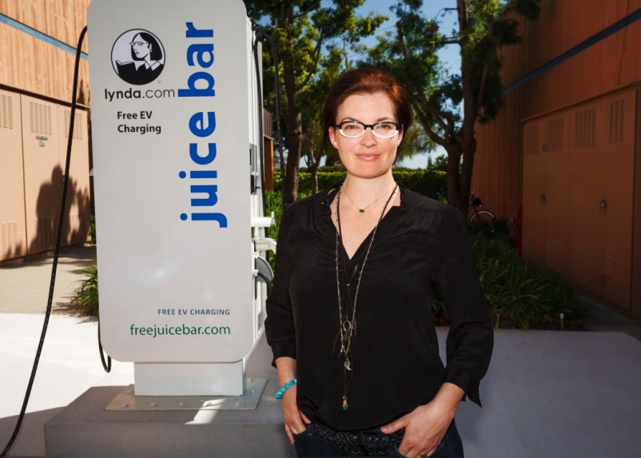
Incentivizes Employees
Incentivizes Employees
Our top candidate for the position included workplace charging as a key factor when making his decision about the job offer. We now have a charging station, a new producer, and other employees have decided to purchase EVs too. You can't put a price on that!
- lynda.com
Notes:
Workplace charging can provide a unique and valuable benefit to employees. Increasing and maintaining employee motivation remains a difficult task for executive management. Installing workplace charging can be an effective way to reward your employees and increase morale. Additionally, providing workplace charging and enabling your employees to drive PEVs can reduce their commuting stress since PEVs can qualify for HOV lane access.
How a company projects its values and ethics has become a competitive differentiator in terms of recruiting. By demonstrating concern for the environment as well as employee quality of life, employers with workplace charging are well positioned to recruit and retain top talent. So not only will installing workplace charging help increase your current employee’s performance, but it can also help position your organization for future employee recruitment.
lynda.com, a 350-person business from a small town in southern California experienced this first hand. When a top-candidate recruit said that workplace charging access would be very important in his decision-making process, lynda.com decided to look into launching a workplace charging program. In the end, they got the employee they wanted and other employees have started buying PEVs as well!
Photo: "lynda.com's PEV charging stations are part of the company's larger commuting program designed to alleviate the impact from employee commutes, which average 40 miles round-trip per day." (Photo by Lucas Deming / lynda.com)
Video: Option to replace photo with embedded version of professional-quality 2-minute video http://www.youtube.com/watch?v=inQnrbXXafw&feature=youtu.be (Video by lynda.com)
[For Ambassadors’ reference]
lynda.com has 350 employees at their Carpintera, CA location. The company’s “Juice Bar” has two 220-volt and four 110-volt outlets that charge both employee cars and the company’s fleet of small PEVs.

Slide 11
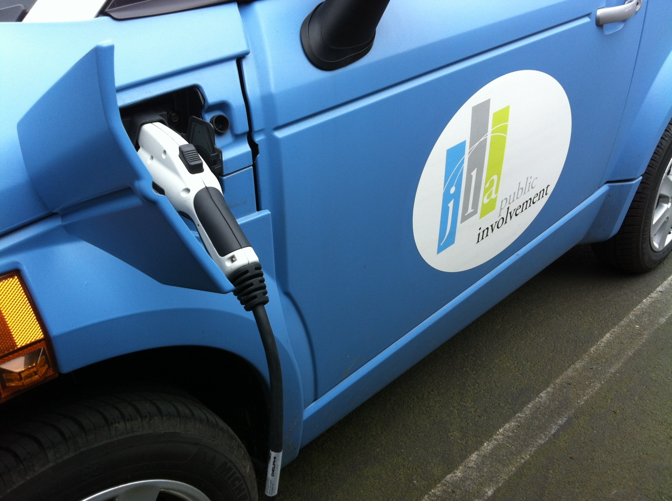
Complements Sustainability Efforts
Complements Sustainability Efforts
Purchasing a plug-in electric vehicle and installing a charging station has expanded our sustainability efforts and allowed us to achieve Gold certification in the City of Portland's Sustainability at Work program.
- JLA Public Involvement
Notes:
Integrated into your organization’s sustainability efforts, workplace charging can enhance your organization’s image and raise brand awareness, creating value for your customers, community, and investors.
Charging station installations qualify for credit under the Green Building Council’s LEED certification process, thereby contributing toward your organization’s efforts in green building (1). By accounting for the emission reductions afforded by your PEV-driving employees’ commutes, workplace charging can reduce your company’s carbon footprint (this is also known as Scope 3 emission reduction).
JLA Public Involvement is a Workplace Charging Challenge Partner and small business out of Portland, Oregon. JLA realizes that sustainability practices are important no matter the size of the organization – in fact, JLA recently received Gold certification in their city’s Sustainability at Work program. With one shared PEV and 3 employees driving plug-ins, JLA boasts a 20% adoption rate among its 15 workers!
US Green Building Council, 2009 “LEED 2009 for Core and Shell Development” http://www.usgbc.org/Docs/Archive/General/Docs8870.pdf and US Green Building Council, 2009 “LEED 2009 for New Construction and Major Renovations” http://www.usgbc.org/Docs/Archive/General/Docs8868.pdf
Photo: "JLA Public Involvement has on-site charging that is available for use both by employees' personal vehicles and by a PEV in the company's corporate vehicle pool, which can be used for all company trips." (Photo courtesy JLA)
[For Ambassador’s reference]
JLA Public Involvement has 15 employees and 1 charging station. The charging station provides power for the company’s single company PEV as well as three personal employee PEVs.

Slide 12
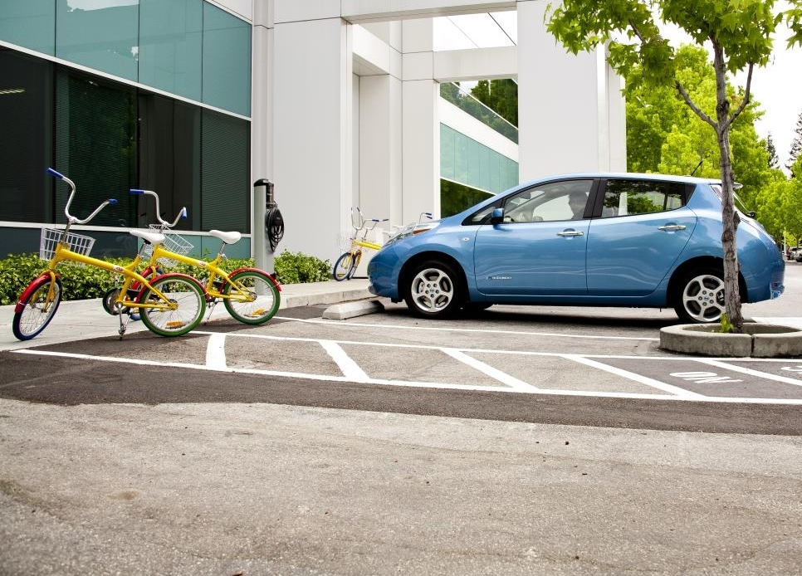
Signals Corporate Leadership
Signals Corporate Leadership
At Google, we believe that plug-in vehicles are game-changers in the effort to reduce the carbon footprint of transportation, improve air quality, and increase the adoption of intermittent renewable energy sources… We’re delighted to help drive progress in this space, and invite others to join the charge towards more EV infrastructure, cleaner air, and a sustainable future.
- Google
Notes:
Workplace charging can also enhance an innovative organizational culture by helping to develop structural and social capital. It shows your consideration and care in your employees’ work and personal lives.
It also showcases an organization’s ability to adapt, position, and prepare for the future – the charging station in your parking lot becomes a visual symbol for this mindset.
A leader in workplace PEV deployment since 2007, Google is a founding Workplace Charging Challenge Partner. Google acknowledges this leadership and encourages other employers to join their efforts. They have been a champion of sharing their lessons learned over the years and aim to eventually provide charging at 5% of their parking spaces. With more than 300 charging stations already deployed across the country, they are well on their way to their target.
Photo: "To support its corporate car share program and encourage its employees to buy their own PEVs, Google offers free workplace charging at its Mountain View headquarters and several other company locations in the United States." (Photo courtesy Google)
[For Ambassadors’ reference]
Google has 25,000 employees and 300 charging stations across the country. The company’s goal is to provide charging at 5% of its parking spaces.

Slide 13
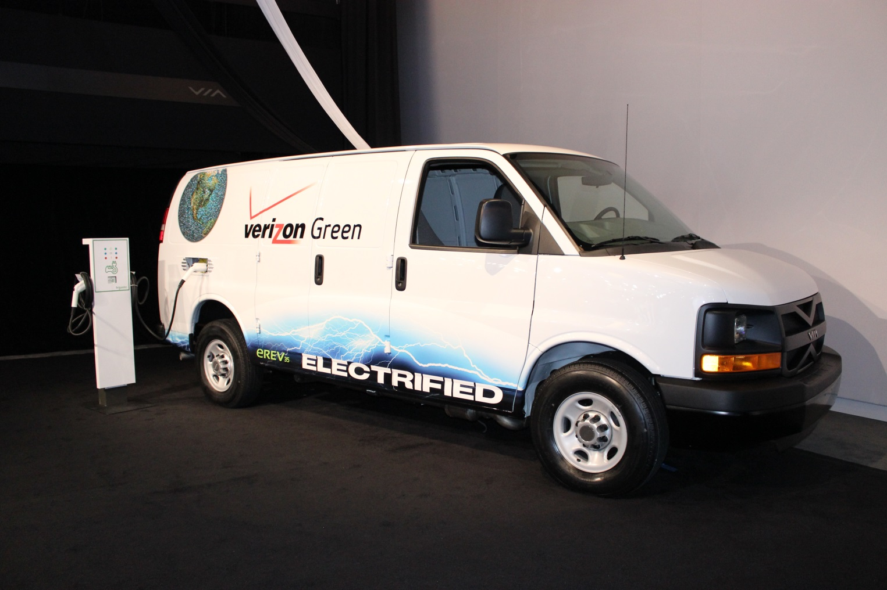
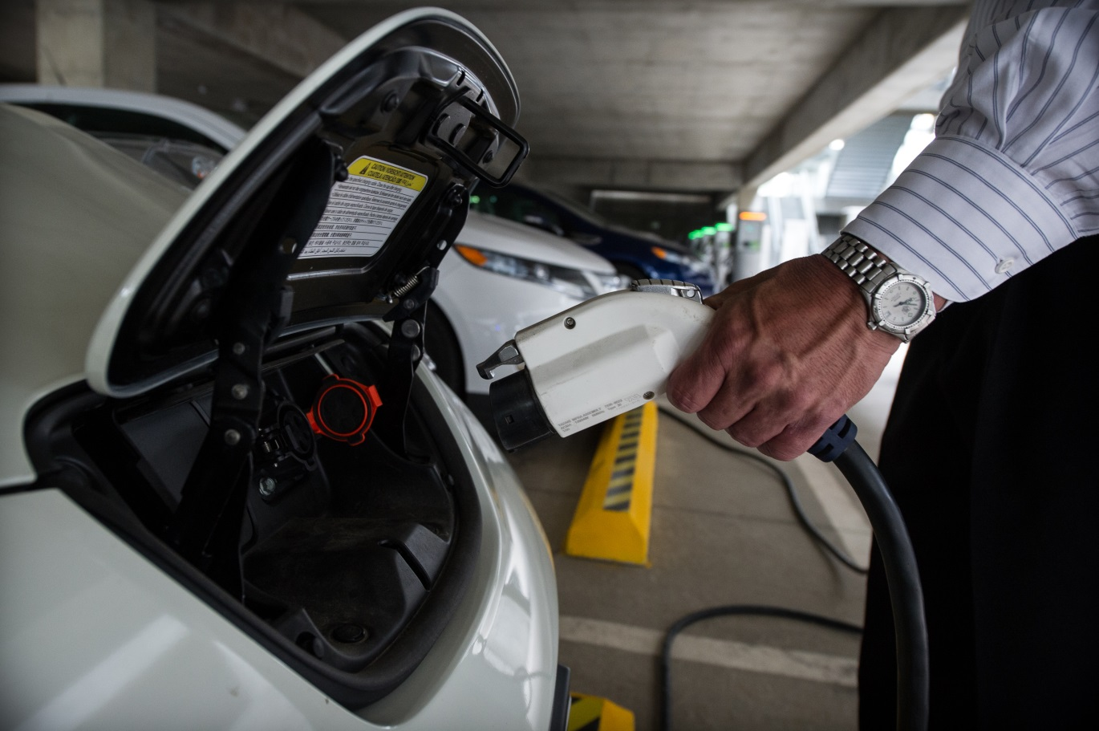
Build On Fleet Fuel Diversification
Promoting more sustainable fleets and the use of alternative fuel vehicles is part of Verizon’s commitment toward meeting ambitious sustainability goals in all areas of its business.
- Verizon
Notes:
Workplace charging can also be a great next step for organizations that are already working to integrate alternative fuel vehicles into their fleet. Through the Department of Energy’s National Clean Fleets Partnership, Verizon has increased its alternative energy vehicle fleet, composed of biofuels, compressed natural gas, hybrids and electric vehicles, to more than 2,500 vehicles (1).
Now a part of our Workplace Charging Challenge, Verizon has set its sights on expanding their charging station offerings to employees.
As a first step in gauging employee interest, Verizon surveyed members of the “Verizon Green Team,” which consists of more than 10,000 employees in 23 countries who are passionate about the improving the environment. They found that more than 80% of respondents would be more interested in purchasing an electric vehicle if they had a place to charge it at the office!
With that in mind, Verizon is casting a wider net and conducting employee surveys to determine its next locations to expand their charging station program in 2014.
US Department of Energy, 2012 “National Clean Fleets Partner: Verizon” http://www1.eere.energy.gov/cleancities/verizon.html
Photo 1: Courtesy Verizon; Photo 2: by Dennis Schroeder / NREL
[For Ambassadors’ reference]
Verizon has 180,000 domestic employees and now has three workplaces with charging stations: a retail store, data center, and call center. The amount of charging stations available at these locations has not been reported to DOE by Verizon.

Slide 14
Commitment-based Voluntary Partnership
DOE
Workplace Charging Challenge
Ambassador
Partner
Notes:
In an effort to provide yet another benefit of workplace charging, DOE has established the Workplace Charging Challenge. With a voluntary partnership model that has proven to be successful in the past, the Challenge has three key participants:
DOE will provide employers with technical assistance and establish a network of best practices. DOE will also recognize the success of workplace charging programs and raise the profile of workplace charging.
As an Ambassador, we at <Organization Name> are working to promote workplace charging in our community and will also support employers in their efforts to establish workplace charging programs.
And most importantly, America’s employers are called upon to act as Partners in the Challenge. As a Partner, an employer makes commitment to develop and execute a Partner Plan at a minimum of one major employer location with a best practice goal of meeting all PEV-driving employee demand.

Slide 15
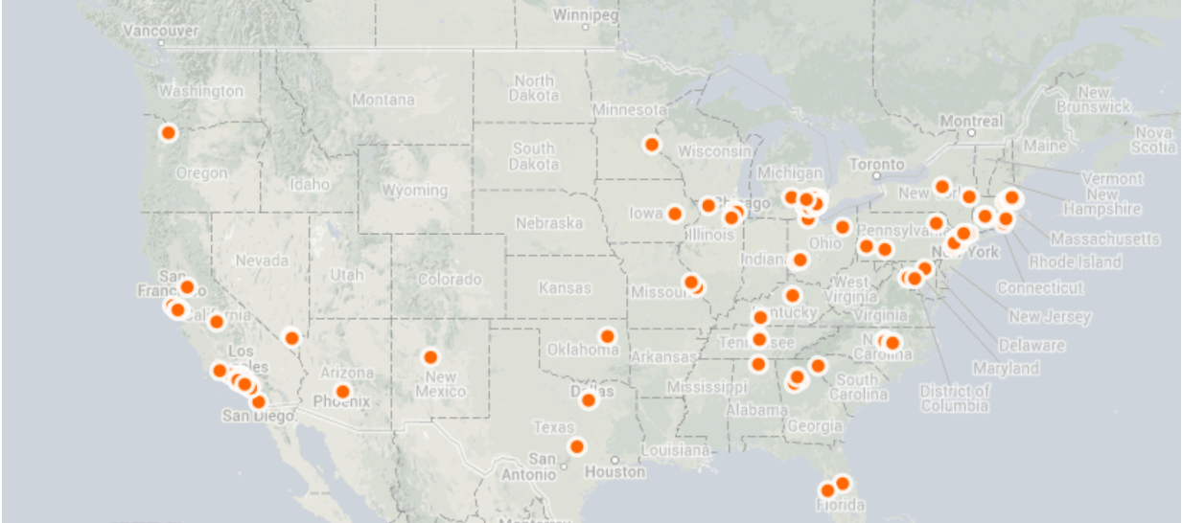
Partner Recognition
Notes:
In addition to providing technical resource assistance, the Workplace Charging Challenge aims to recognize employers for their workplace charging efforts.
The Workplace Charging Map shows where our Partners have workplace charging installed across the country. The map serves as an advertisement to current and potential PEV drivers where they can find employers in their community or industry who offer this important benefit.
[CLICK ANIMATION 1] Hosted on the Department of Energy website, Partner Profiles give a snapshot of the steps that each employer is taking to implement their Workplace Charging Plan.
[CLICK ANIMATION 2] DOE is also using its communications channels to raise the profile of workplace charging and give exposure to Partner employers. This is done through speeches, press releases, national and local media interviews, blog posts and social media.

Slide 16






National Recognition: The Challenge
Energy Sec. Chu: More Electric Vehicles, Less U.S. Dependence on Foreign Oil
Workplaces offer electric car charging for employees
Turning Employees On to Conservation
Could Electric Vehicles Fly Out of Showrooms?
Jump-starting electric vehicle sales with workplace charging stations
Go Ahead, Ask Your Boss About Workplace EV Charging
Notes:
The Workplace Charging Challenge has received over 125 unique media pickups since its launch in January 2013. This media attention has come from a variety of media outlets and news sectors across the country.

Slide 17






National Recognition: Partners
MetLife Unveils Innovative Electric Car Charging Program for Its Employees at 14 U.S. Campuses
Auburn Hills Named Partner in Workplace Charging Challenge
Coca-Cola, GE join push for electric vehicle charging stations
Google, Ford, GE Pledge Workplace EV Stations
Lynda.com's New Workplace Perk: Electric Car Charging Station
Dominion installs vehicle charging stations on Richmond campus
Notes:
We’re also working with Partners to spread the word about their workplace charging efforts at the local and national level. While employee benefits usually are confined to employee newsletters, these employers are getting the community recognition that they deserve for their workplace charging programs.
Taking on the Challenge will further elevate your public image and allow you to reach an even wider audience whether it be potential customers, investors or employees.
The message is clear: if you have a PEV-driving workforce and you want to be seen as innovative and sustainable organization, you should consider joining the Workplace Charging Challenge.

Slide 18
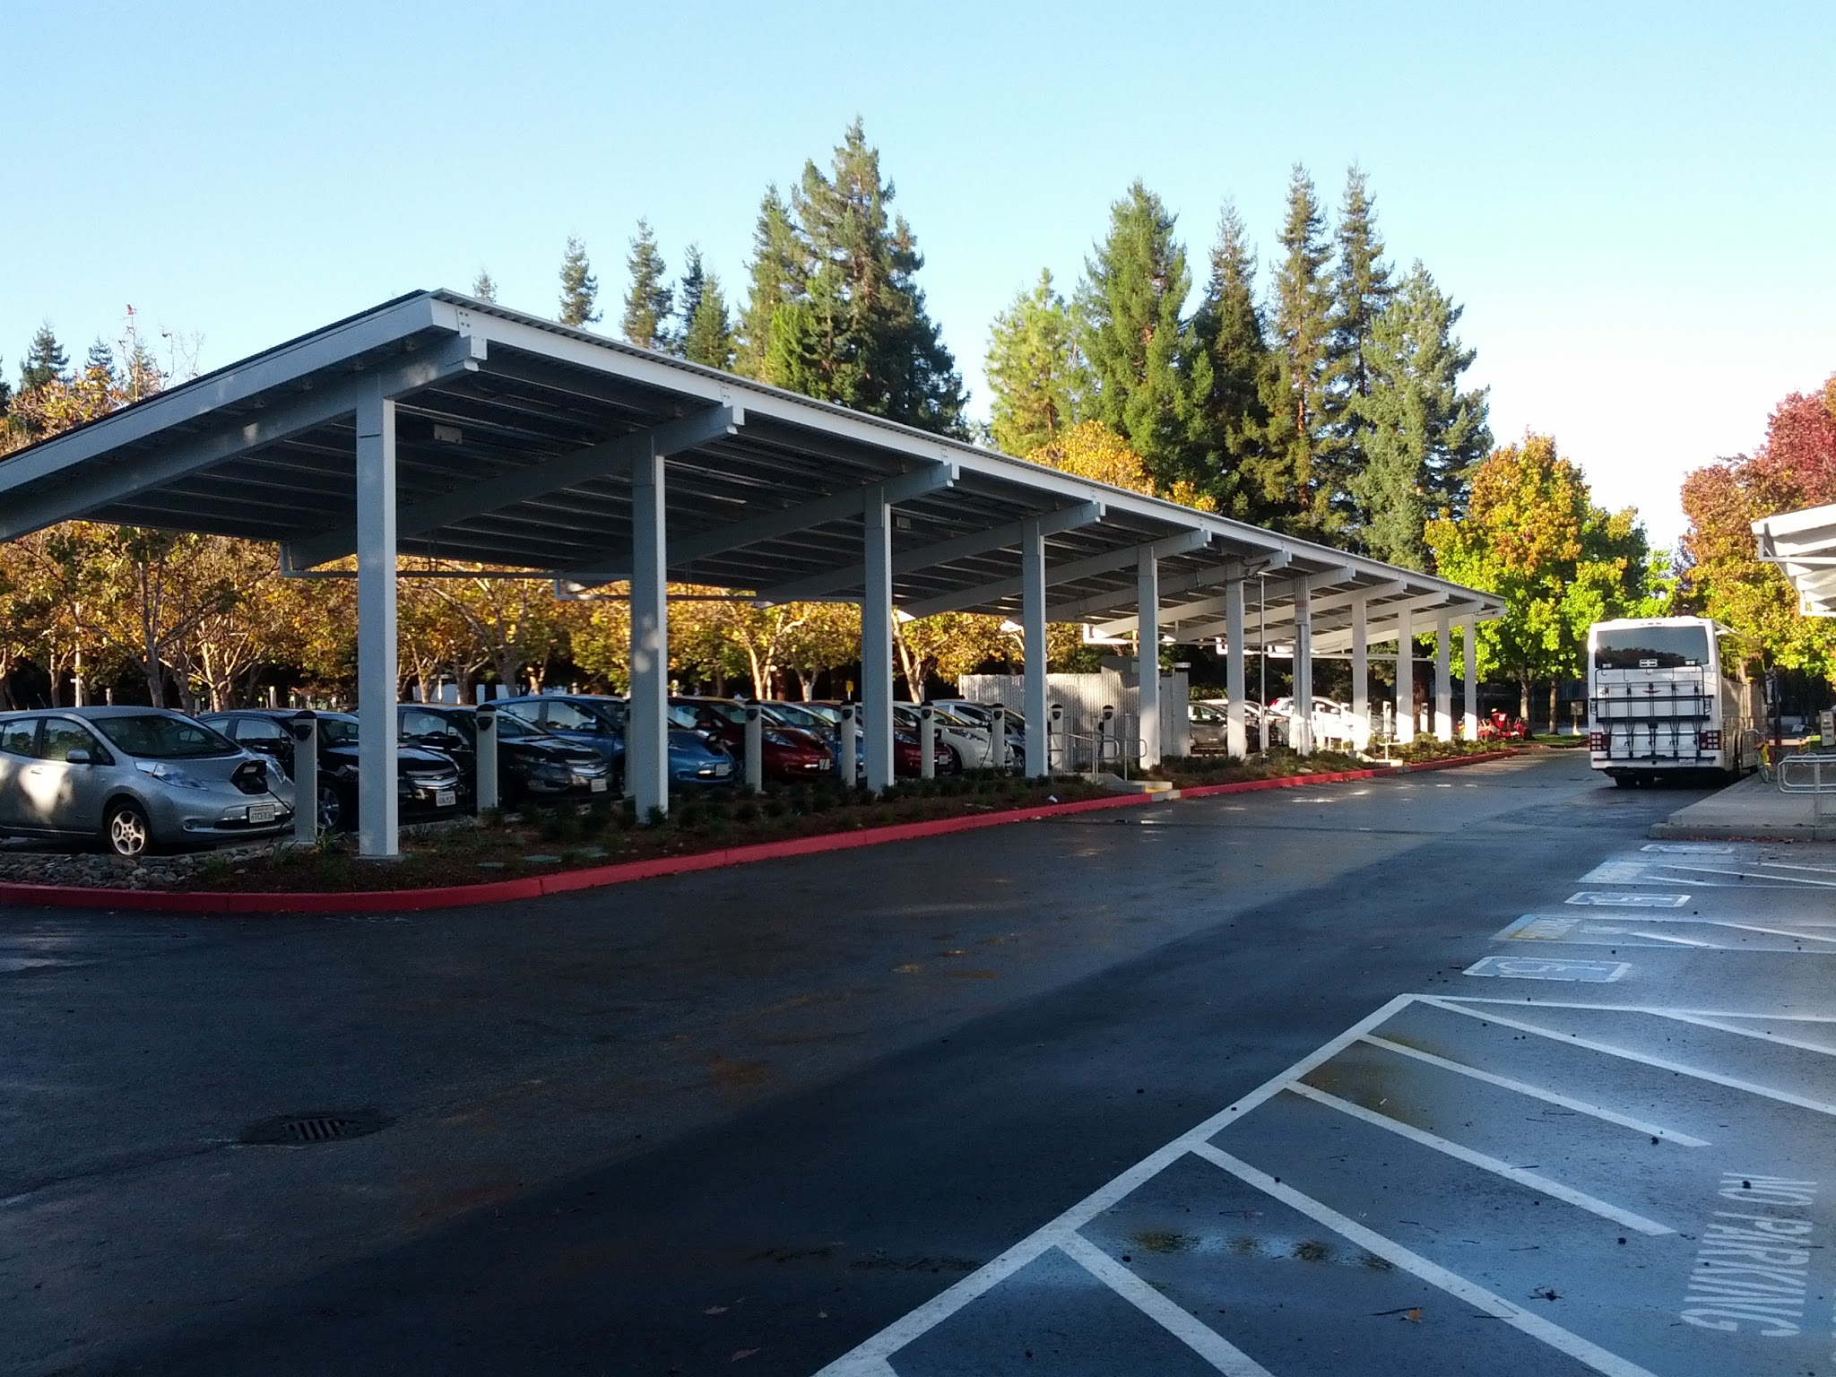
Workplace Charging Solutions
Procurement & Installation
Understanding charging station options
Understanding incentives
Working with property owners
Understanding permitting & zoning rules
Working with electrical contractors
Achieving ADA compliance
Identifying optimal signage
Notes:
As you begin to assess whether or not a workplace charging program is right for your organization, the question of “How much money, time and effort will establishing a workplace charging program cost my organization?” is very important.
Of equal importance is knowing that there are technical and potentially financial resources available – and we can help you navigate your options.
First, how much will it cost to procure and install the charging stations? There are a variety of charging stations on the market and those units vary in features and prices. Level 1 charging stations range in cost from $500 to $1,000 while Level 2 units, which can charge a vehicle faster, can cost anywhere from $500 to $7,000 (1). We can work with you to determine whether or not you are eligible for a 30% federal tax credit and find out if other state, utility and charging station provider incentives are available. Additionally, we can work with you to plan in a way that can help you minimize electrical upgrade and electrical conduit trenching costs associated with the installation process.
If your worksite is on leased property, working with property owners can be challenging, as can understanding our areas permitting and zoning rules for charging station installation. Since we’ve worked with others on these issues before, our organization can help make this process easier. DOE has even created videos to assist electrical professionals during the installation process.
Lastly, it is important to understand how to achieve ADA compliance and identify optimal signage for your charging station parking spots. While these are both issues that are still evolving, we’re learning what is working best in communities across the country and want to share those best practices with you.
US Department of Energy Plug-In Electric Vehicle Handbook for Workplace Charging Hosts, 2013
Photo: "With more than 300 charging stations already deployed across the country, Google's goal is to provide charging at 5% of its parking spaces." (Photo courtesy Google)
[For Ambassadors’ reference]
Google has 25,000 employees and 300 charging stations across the country. The company’s goal is to provide charging at 5% of its parking spaces.

Slide 19
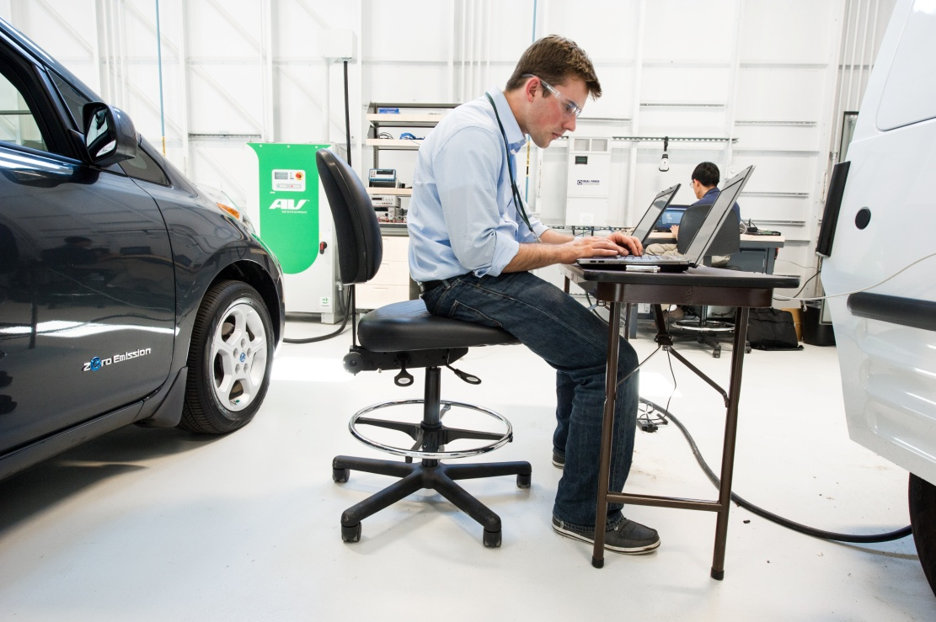
Workplace Charging Solutions
Management & Policy
Monitoring electricity & usage
Setting an employee pricing system
Establishing employee fairness
Working with utilities on demand charges
Determining management logistics
Communicating legal liability
Developing parking etiquette
Notes:
As you start to get your charging stations up and running, you’ll consider, “How will I develop an internal management system and policy that integrates seamlessly into my organization’s operations?”
It may be surprising to hear that the electricity used by a workplace charging station is minimal – in fact, it will cost an average of a only $34 per month per employee (1). Your organization may choose to mitigate these costs by charging your employees a fee for their electricity usage. We can work with you to evaluate the provision of free electricity to your employees, how much you should charge if you decide to do so and discuss the employee fairness and tax implications of these options. We can also work with you and your utility to understand potential demand charges as well.
Employers face unique and potentially time-consuming challenges when determining how the units will be managed, how you will communicate with your insurer on worksite charging safety, and how you will establish a worksite parking and charging etiquette among your employees. Other issues unique to your organization or worksite may also arise over the lifetime of your workplace charging program. But by working with our organization and taking advantage of the best practices and technical assistance of the Workplace Charging Challenge, the task of developing a workplace charging program management and policy can be eased.
(1) US Department of Energy Vehicle Technologies Office, 2013
Photo: “NREL intern Josh Crowley and NREL engineer Myungsoo Jun, run an experiment at the Vehicle Testing and Integration Facility (VTIF).” (Photo by Dennis Schroeder / NREL)

Slide 20
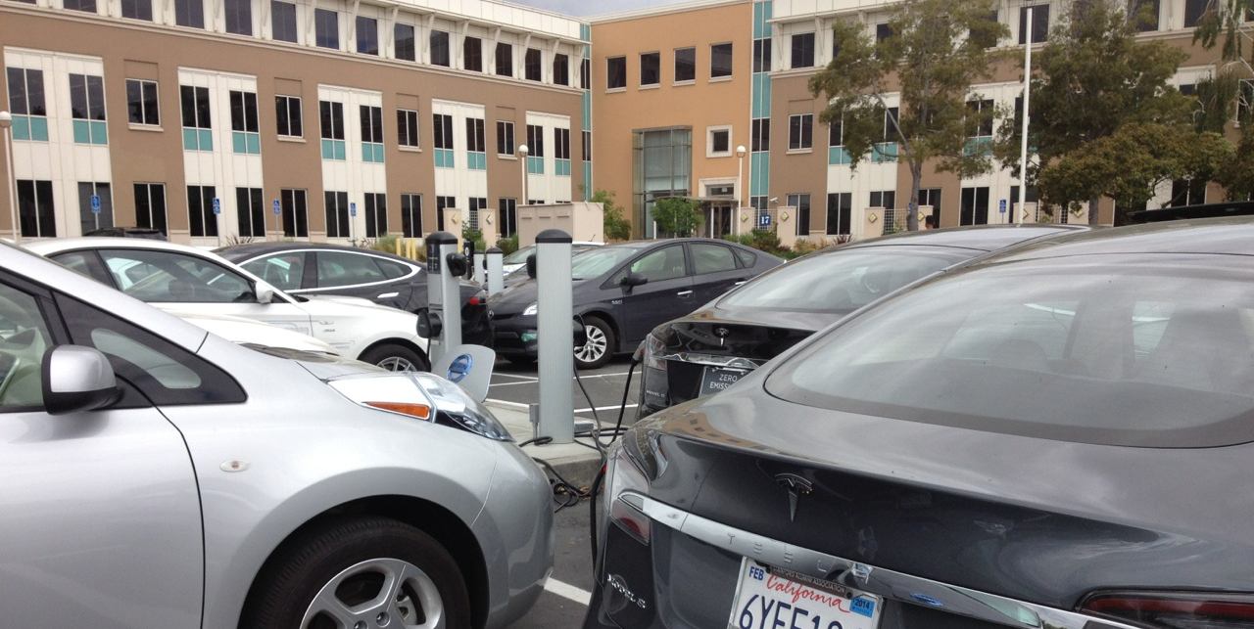
Workplace Charging Challenge Partner
Program Background
Goals and Progress
Demand Assessment
Procurement & Installation
Management & Policy
Activity or Programs
Notes:
If you choose to join the other employers in the Workplace Charging Challenge, we’ll work to integrate the considerations discussed on the previous two slides into your “Partner Plan.” In the Plan you will set goals, measure progress, and assess demand for charging stations. Developing this plan will help minimize barriers and smooth the way towards installing workplace charging at your organization.
Photo: "As part of Facebook's aggressive Transportation Demand Management (TDM) program, the company has committed to supplying free PEV charging to its Menlo Park, California, employees." (Photo by Lauren Bonar Swezey / Facebook)
[For Ambassador’s reference]
Background and Goals/Progress: What is your company’s long-term vision for your WPC program and how will you track progress?
Demand Assessment: How will your company assess your employee’s demand for WPC?
Management/Policy: How will your company’s WPC program be integrated into an effective internal company policy?
Procurement/Installation: How will your company evaluate charging station options and work to install WPC?
Activity/Programs: What other ways is your company working to promote the deployment of EVs?
[For Ambassadors’ reference]
Facebook has 4,500 employees, Currently, the campus has 1 DC Fast Charger and 25 Level 2 charging stations, with plans to install 12 more in 2013. Facebook has also made 21 Level 1 charging stations available to its employees.

Slide 21

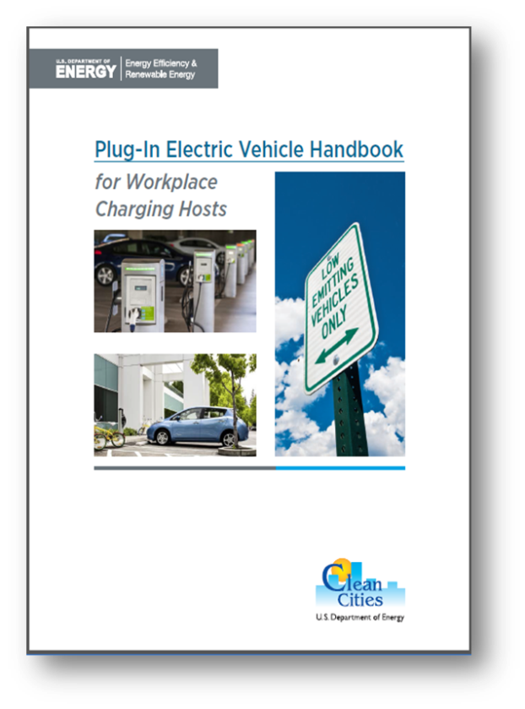
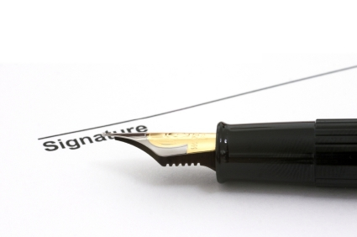
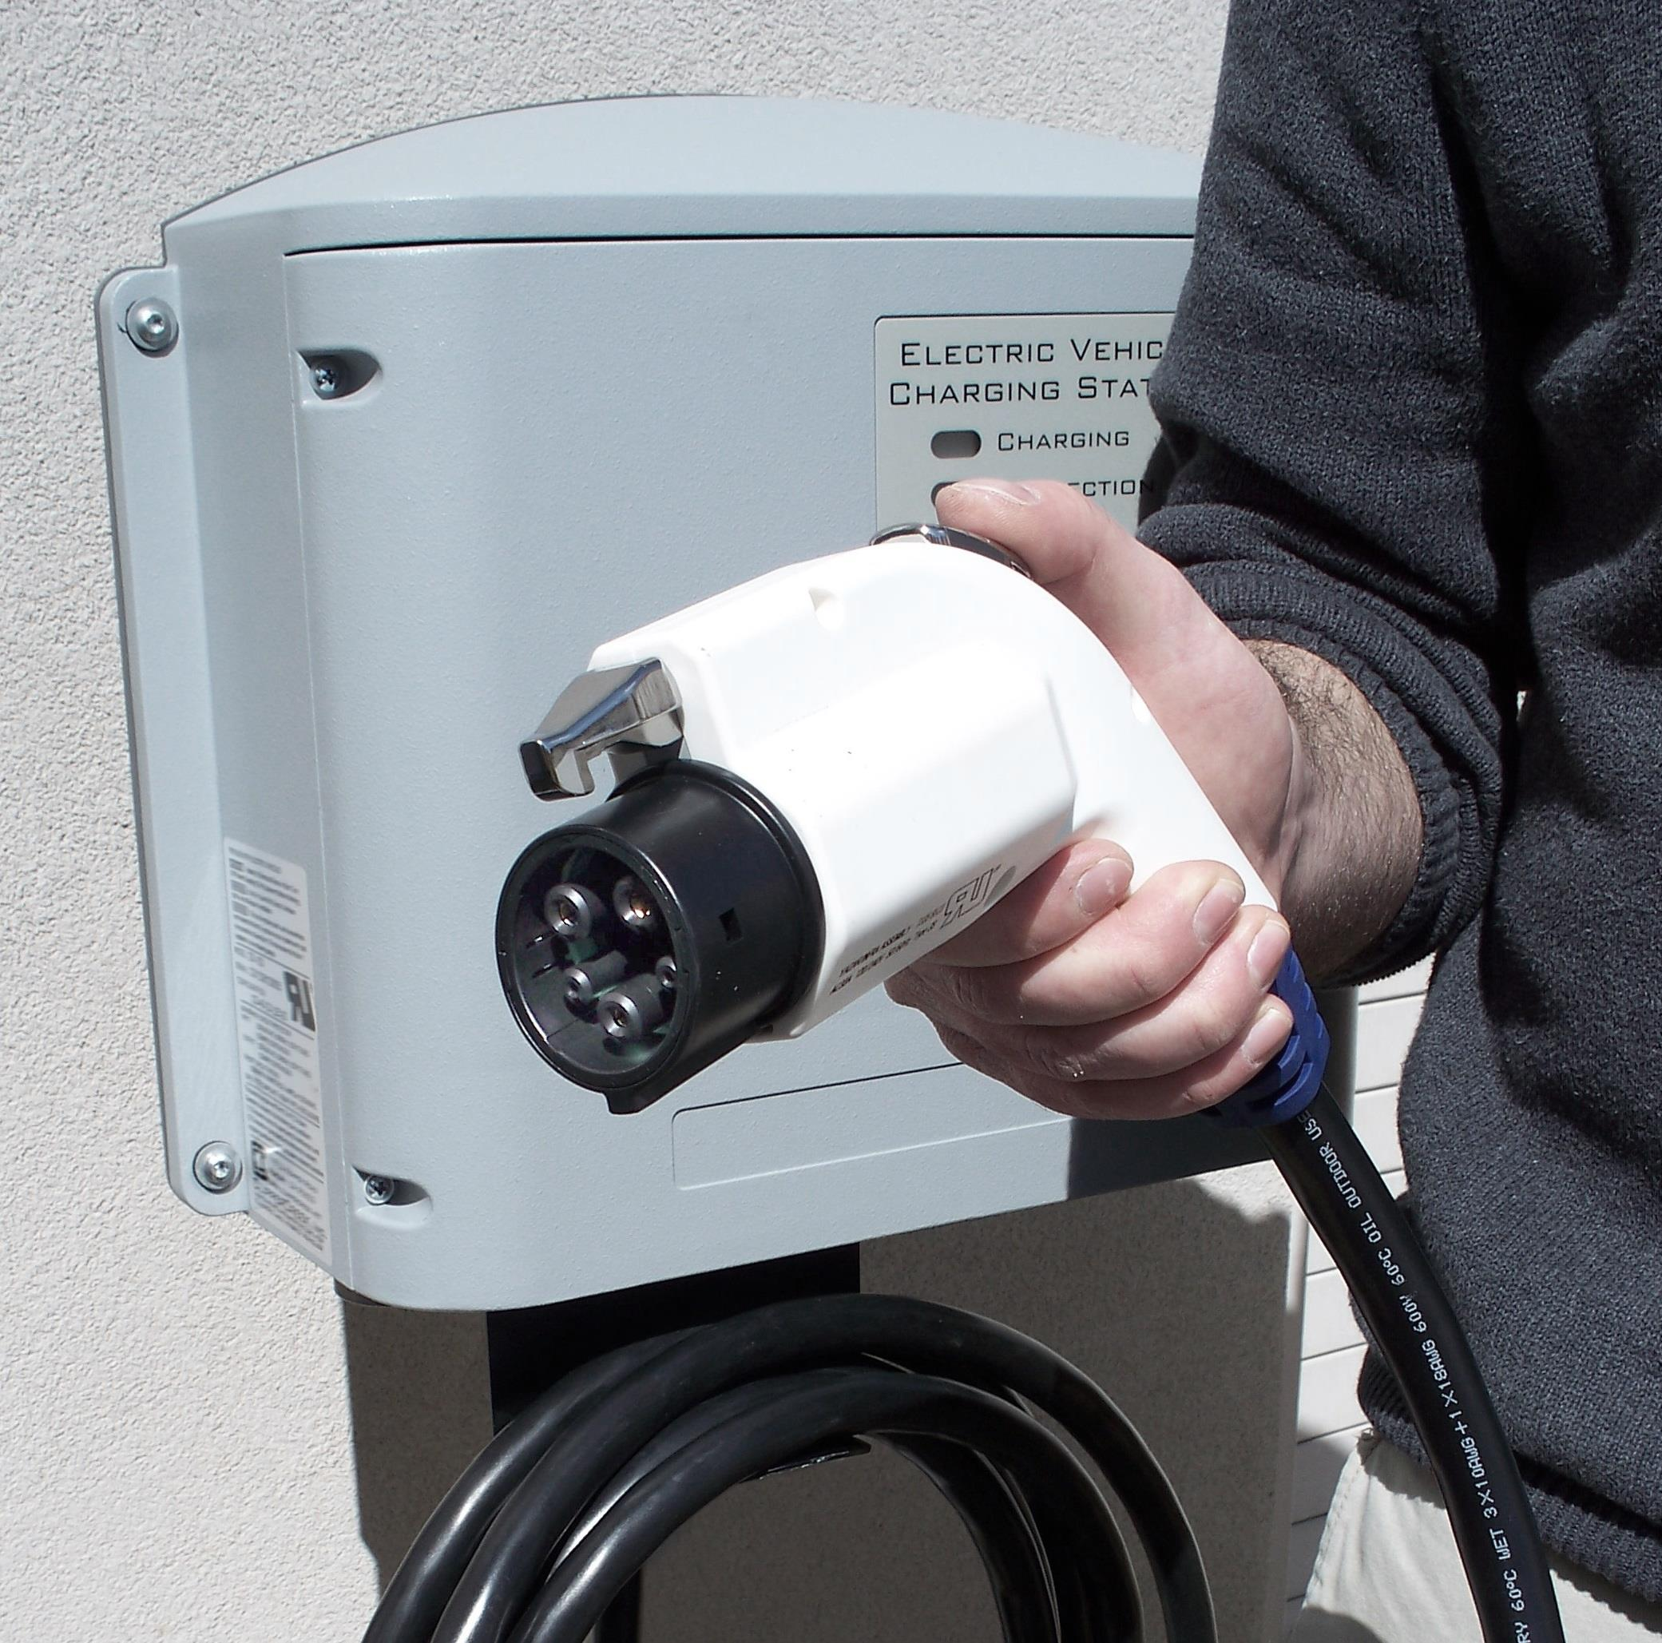
Is Workplace Charging Right for You?
Let’s continue the conversation
Learn more about the Workplace Charging Challenge
Build a successful workplace charging program
Notes:
Ultimately, the amount of money, time and effort that goes into a workplace charging program will vary from organization to organization. Yet many employers that have joined the Workplace Charging Challenge have found the business case combined with the employee and societal benefits to be very compelling. And the benefits of DOE’s Challenge program and having our support doesn’t hurt either!
As for next steps, let’s continue the conversation. [Ambassador Organization] and DOE have a wealth of technical resources and experience that can help you determine if workplace charging is a good fit for your organization. The PEV Handbook for Workplace Charging Hosts (pictured here) is a brand new resource that DOE just released that provides a great introduction to worksite charging. It even provides a sample survey that you can use to start a conversation with employees and gauge their interest in charging at work.
If your organization decides that workplace charging is right for you, you can work with [Ambassador Organization] and DOE’s Workplace Charging Challenge Coordinator to learn more about becoming a Partner employer.
And as you develop your workplace charging program, we’ll help you overcome challenges, amplify your success, and share best practices with other employers.

Slide 22
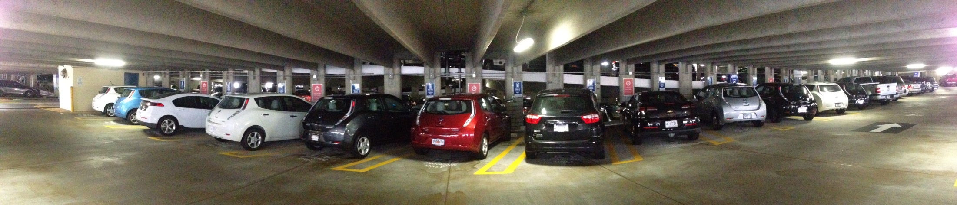
Let’s Continue the Conversation
Presenter’s Name
E-mail address
Phone number
Workplace Charging Challenge
WorkplaceCharging@ee.doe.gov
www.electricvehicles.energy.gov
Ambassador Organization
Ambassador E-mail
Ambassador Website
Notes:
In a time of fluctuating petroleum prices and heightened environmental concerns, many workers see PEVs as a convenient way to reduce driving costs and environmental impacts.
The number of PEVs on U.S. roadways is increasing rapidly, as is the need for charging infrastructure.
Now is a good time to consider hosting workplace charging and becoming a leader in the electrification of transportation.
Thank audience and Q & A
Photo: “After installing 12 Level 1 EVSE charging stations at its headquarters office, Coca-Cola employees have told the company they are making the choice to buy plug-in electric vehicles (PEVs) based on the company's support.” (Photo courtesy The Coca Cola Company)
[For Ambassador’s reference]
Coca Cola has 71,000 employees with 5,000 at their U.S. headquarters in Atlanta, GA. They 12 Level 1 charging stations as of September 2013.

